Slide 1
Welcome to DevOps Basic Configuration Demo
Hello everyone..!!

Slide 2
Agenda
Understand basic Git and GitHub
Understand basic Docker and Docker Hub
Understand basic Jenkins and Jenkinsfile
Understand basic Kubernetes
Demo

Slide 3
Git basic commands
What is git ?
Git is a distributed version-control system for tracking changes in source code during software development.
Installation of git on CentOS:
sudo yum install git –y
Some git commands examples:
git clone
git status
git add
git commit
git push
git pull
git config
What is GitHub ?
GitHub, provides hosting for software development version control using Git.

Slide 4
Docker basic commands
What is Docker ?
Docker is a set of platform as a service products that uses OS-level virtualization to deliver software in packages called containers. Containers are isolated from one another and bundle their own software, libraries and configuration files; they can communicate with each other through well-defined channels.
Docker installation on CentOS:
curl -fsSL https://get.docker.com -o get-docker.sh
sudo sh get-docker.sh
Some Docker commands examples:
Docker info
Docker images
Docker ps and docker ps –a
Docker run
Docker login
Docker pull
Docker push
What is Docker Hub ?
Docker Hub is a service provided by Docker for finding and sharing container images with your team.
Reference link:
https://docs.docker.com/engine/install/centos/

Slide 5
Dockerfile
FROM nginx:latest
ADD index.html /usr/share/nginx/html/
RUN chmod +r /usr/share/nginx/html/index.html
CMD ["nginx", "-g", "daemon off;"]

Slide 6
What is Jenkins ?
Jenkins is an open source automation tool written in Java with plugins built for Continuous Integration purpose. Jenkins is used to build and test your software projects continuously making it easier for developers to integrate changes to the project, and making it easier for users to obtain a fresh build.

Slide 7
Jenkins installations
Jenkins installation on CentOS 7.
Jenkins requires Java in order to run.
sudo wget -O /etc/yum.repos.d/jenkins.repo http://pkg.jenkins.io/redhat-stable/jenkins.repo
sudo rpm --import http://pkg.jenkins.io/redhat-stable/jenkins.io.key
sudo yum install Jenkins –y
Jenkins service:
sudo systemctl status Jenkins
sudo systemctl start Jenkins
sudo systemctl enable Jenkins
sudo systemctl stop Jenkins
Add Jenkins user to the docker group:
sudo usermod –aG docker jenkins
Reference link:
https://wiki.jenkins.io/display/JENKINS/Installing+Jenkins+on+Red+Hat+distributions

Slide 8
Jenkins required Plugin
Pipeline Plugin
GitHub Plugin
Maven Plugin
Kubernetes Continuous Deploy Plugin
Credentials Plugin
Email Extension Plugin

Slide 9
Jenkinsfile Syntex
pipeline {
agent any
stages {
stage(‘Stage Name 1') {
steps {
script {
Statement…..!!
}
}
}
stage(‘Stage Name 2') {
steps {
script {
Statement…..!!
}
}
}
}
}

Slide 10
Kubernetes Installation
What is Kubernetes?
Kubernetes is an open-source container-orchestration system for automating
application deployment, scaling, and management.
Installation:
Please refer the below mentioned link:
https://github.com/justmeandopensource/kubernetes/blob/master/docs/install-cluster.md
Flannel:
https://github.com/coreos/flannel#flannel

Slide 11
Kubernetes basic commands
kubectl cluster-info
kubectl get nodes or kubectl get nodes -o wide
kubectl get namespace
kubectl get pods
kubectl get replicaset
kubectl get deployment
kubectl describe pods pod-name
kubectl get events
kubectl logs pod-name
kubectl config

Slide 12
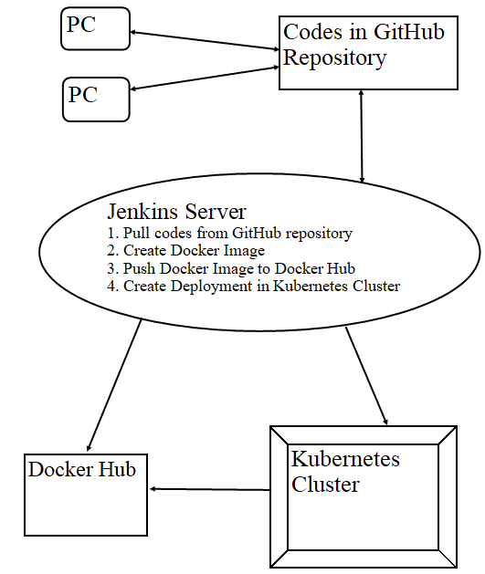
Workflow

Slide 13
Demo
Java Application:
Using below tools,
a) git and github
b) dockerfile and docker hub
c) Jenkins pipeline
d) kubernetes
2. Java Application:
Using below tools,
a) git and gitlab
b) dockerfile and docker registry
c) Jenkins pipeline
d) kubernetes

